Slide 1
Install & run Python Digital Image Processing
Dep. of Computer Science & Information Engineering, Asia University
Associate Professor
Rung-Sheng Chen

Slide 2
1. Installation
2. Install image processing library
3. Start your first DIP by python
4. Run at python IDLE
5. Reference

Slide 3
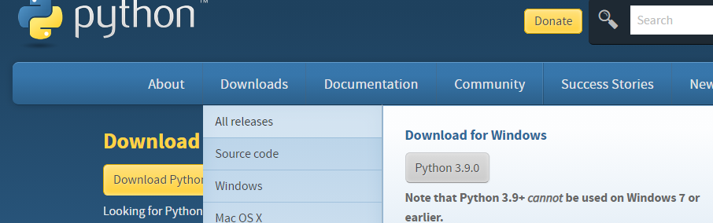
1.Installation

Slide 4
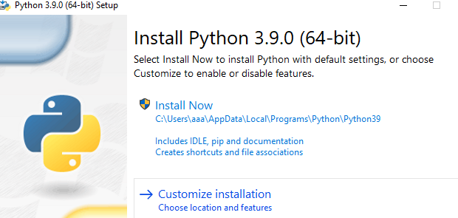

Slide 5
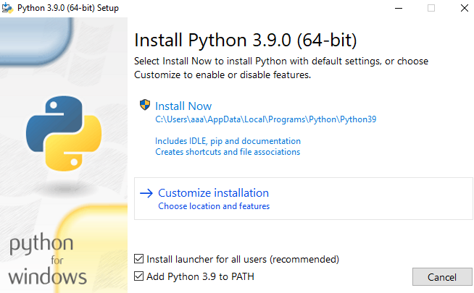

Slide 6
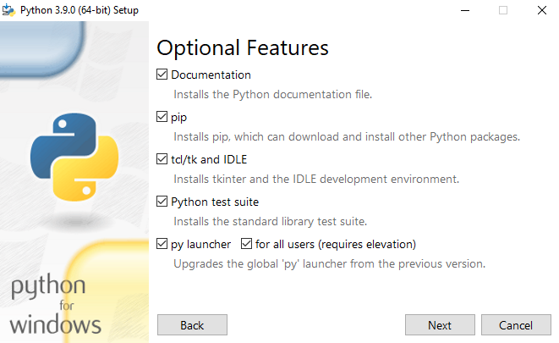
Select the default settings，and click next

Slide 7
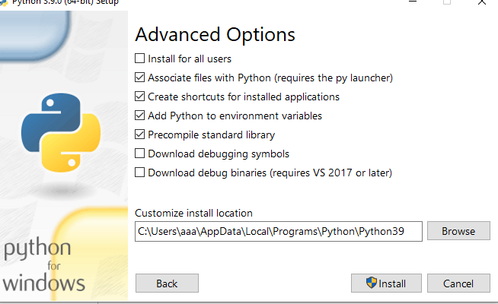
Click Install，

Slide 8
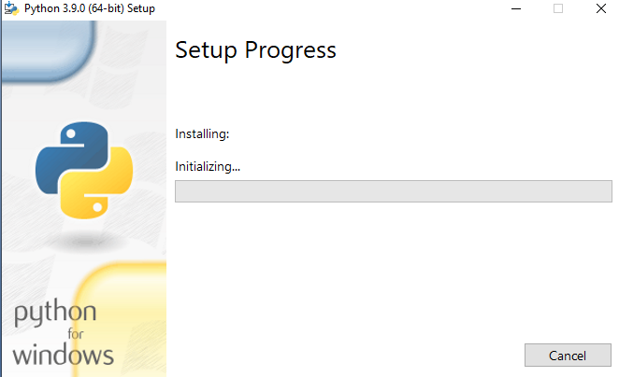
installing...

Slide 9
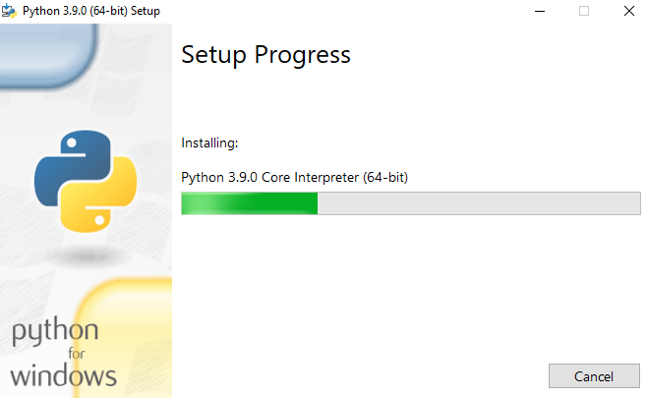
installing...

Slide 10
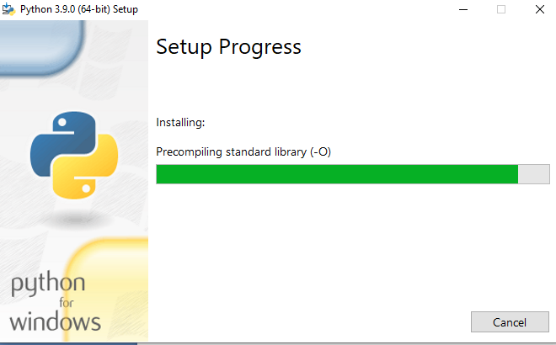
installing...

Slide 11
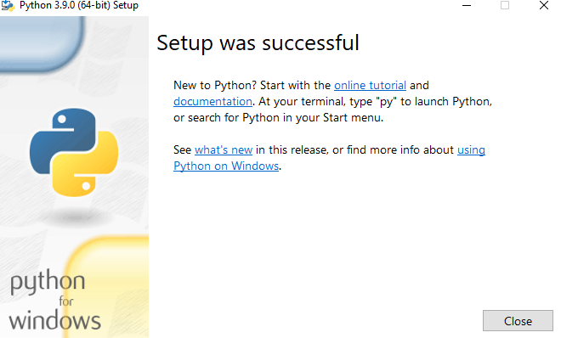
Successful set up

Slide 12
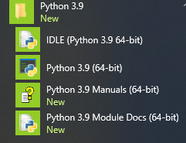
After installation, let's test the environment briefly. First, click Start > all applications in Windows system to find the folder of python3.9, and the options of the following figure will appear.

Slide 13
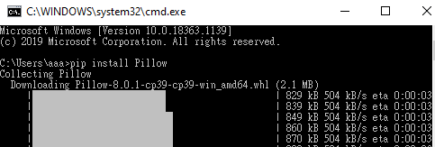
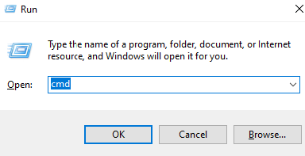

2. Install image processing library
2. install image processing library
(1)
(2)
2-1 install Pillow
pip install Pillow

Slide 14
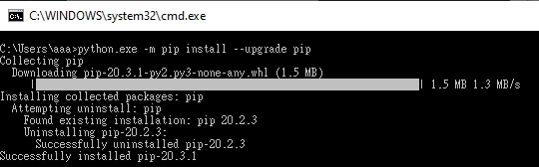
pip upgrade
python.exe –m pip install –user –upgrad pip

Slide 15
2-2 install scikit-image
python –m pip install scikit-image

Slide 16

python –m pip install scikit-image

Slide 17
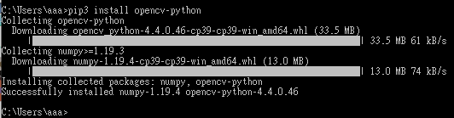
2-3 Install cv2
pip3 install opencv-python

Slide 18
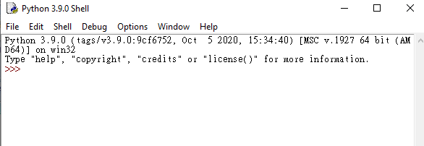
3. Start your first DIP by python
(1) open python IDLE

Slide 19
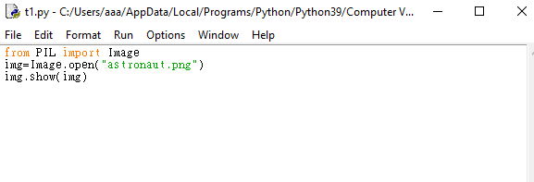
(2)create a program named t1.py saved at the corresponding folder

Slide 20
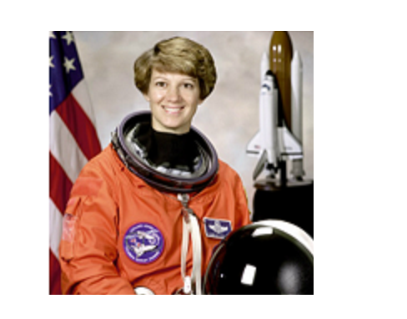

4.Run at python IDLE(short for Integrated Development and Learning Environment)
After run it, we get

Slide 21
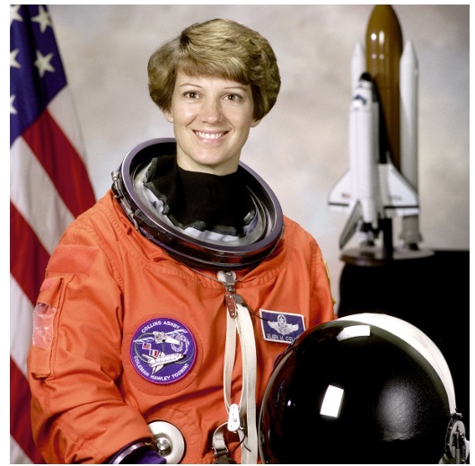
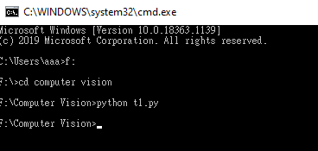
At cmd, we can run the program by

Slide 22
5. Reference
https://www.python.org/

